Slide 1
PILLAI COLLEGE OF ENGINEERING
Internet Of Things (IoT) And Big Data (BDA) For
Disaster Management
EXTC B
Divya Ramesh Mokal
Adarsh Baburaj Nambiar
Sachin Siyalal Saroj
Vaibhav Dadarao Sawant
Prakash Bhuraram Sirvi

Slide 2
Objectives
Introduce IoT and BDA
Enhance Data Analytics, comprehend disasters
Gain confidence - explore new avenues
Software for tackling calamity

Slide 3
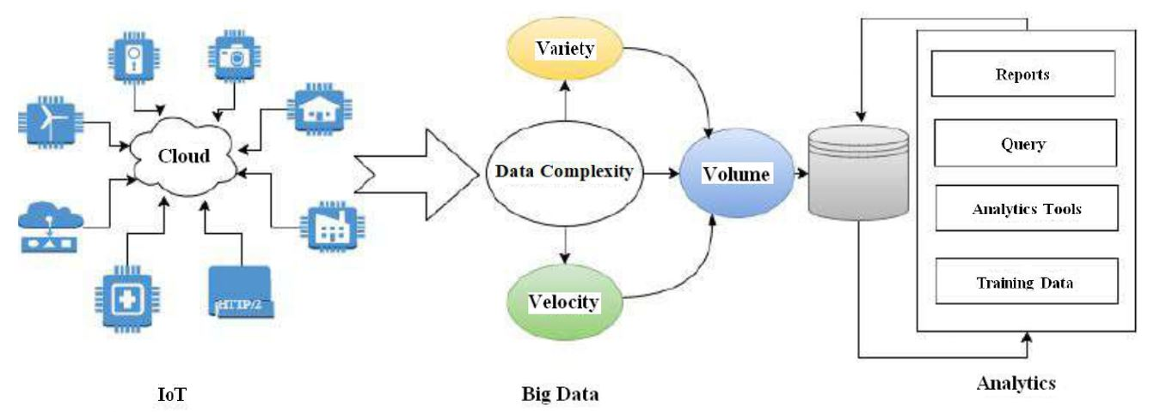
Introduction
Real-time disaster monitoring
Data pre-processing and aggregation.

Slide 4
Literature Review
M.Khalid; ”A review on Applications of Big Data for Disaster Management” (2017)
Pieman Alipour Sarvari; “The Potential of Data Analytics in Disaster Management”. (2019)
implements a fully integrated disaster information management system providing the access to the agencies
highlights the need for innovative disaster decision support system, working upon real-time big data.

Slide 5
Literature Review
Partha Pratim Ray; “Internet of Things for Disaster Management ” (2021)
Sufian Hameed; ”Towards Disaster Resilient Smart:Can IOT and Big Data Analytics be the Game Changers” (2017)
represents the information of disaster management which involves phases of disasters
discusses the novel reference architecture and philosophy of a disaster resilient smart city (DRSC)

Slide 6
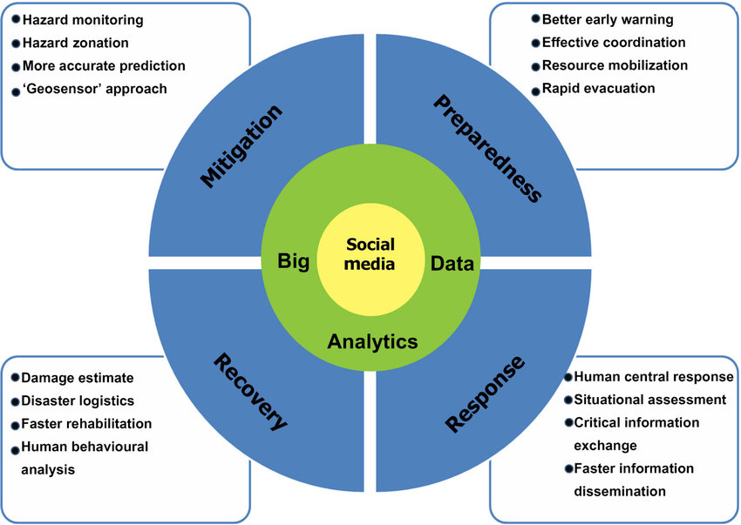
Research Methodology
Internet of Things for Disaster Management (2021)

Slide 7
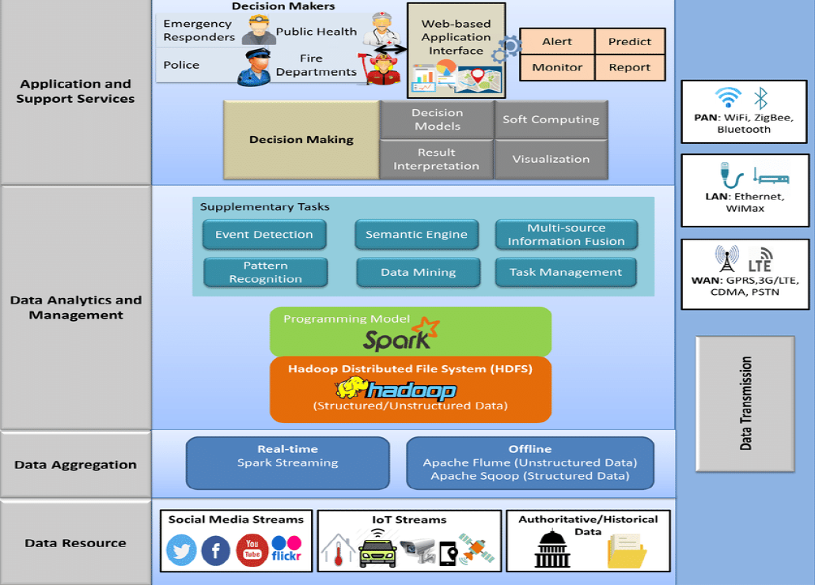
Experiment and Result
Disaster Management in Smart Cities using IoT and Big Data
by Akil Ramesh, S Rajkumar, Jenila Livingston L M
The implementation model consists of five layers
Data resource layer
Data transmission layer
Data aggregation layer
Data analytics
Application and Support services layer
Data transmission layer

Slide 8
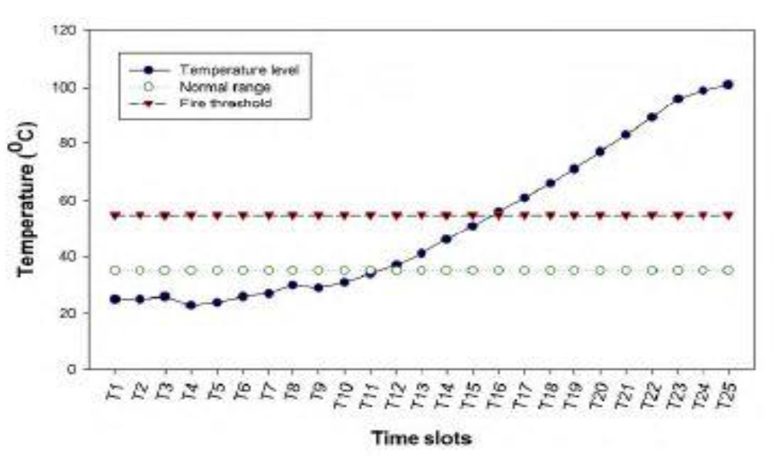
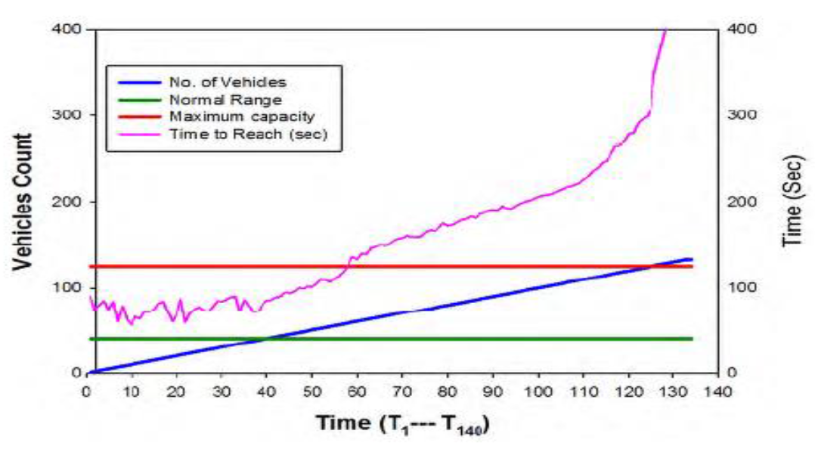
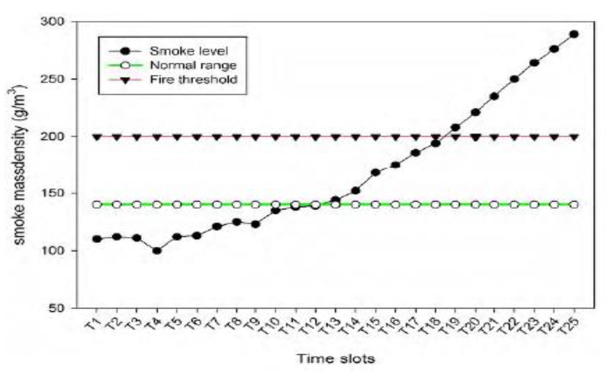
Experiment and Result
Z-score normalization is used to calculate the value by dividing the standard deviation of the data set.
Result of blockage level monitoring system
Result of fire level monitoring system
Result of pollution level monitoring system

Slide 9
DISCUSSION
Disaster Data Quality
Data Reliability
Privacy and Security

Slide 10
Conclusion
Advantages of BDA and IoT
Future Implementation for BDA and IoT in Disaster Management
Architectural deployment of BDA and IoT in Disaster Management
Benefits of BDA and IoT in Disaster Management

Slide 11
FUTURE SCOPE
Integration with artificial intelligence
Integration with Machine Learning .
Integration with Microlocation

Slide 12
REFERENCE
S. Shah, D. Seker, S. Hameed, D. Draheim, “The Rising Role of Big Data Analytics and IoT in Disaster Management,” IEEE, 2019.
M. Khalid, A. Roxin, C. Cruz, D. Ginhac, “A Review on Applications of Big Data for Disaster Management,” 2017.
Ko Ko Lwin; Yoshihide Sekimoto; Wataru Takeuchi; Koji Zettsu, &quot,”City Geospatial Dashboard: IoT and Big Data Analytics for Geospatial Solutions Provider in Disaster Management”, 2019.
Pieman Alipour Sarvari; Mohammad Nozari; Djamel Khadraoui, “The Potential of Data Analytics in Disaster Management”,2019.
Akil Ramesh, S Rajkumar, Jenila Livingston L M ``Disaster Management using IoT and Big Data“,2020.
Manzhu Yu, Chaowei Yang ID and Yun Li I “Big Data in Natural Disaster Management”,2018.
Partha Pratim Ray, Mithun Mukherjee and Lei Shu “Internet of Things for Disaster Management”, 2021.
Ashish Rauniyar; Paal Engelstad; Boning Feng; Do Van Thanh in “Crowd sourcing-Based Disaster Management Using Fog Computing in Internet of Things Paradigm”, 2016.
Prabodh Sakhardande; Sumeet Hanagal; Savita Kulkarni , “Design of disaster management system using IoT based interconnected network with smart city monitoring system”, 2016.
Syed Attique Shah; Dursun Zafer Şeker; M. Mazhar Rathore; Sufian Hameed; Sadok Ben Yahia; Dirk Draheimwe, ” Towards Disaster Resilient Smart Cities: Can Internet of Things and Big Data Analytics Be the Game Changers?” IEEE, July 2019.

